Slide 1
ATM Management system

Slide 2

Agenda
Introduction
Features
Implementation
End!

Slide 3
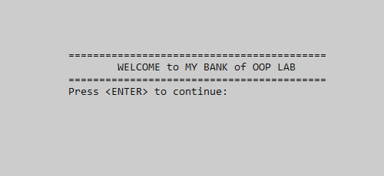
Introduction
In our ATM Management System, the front User interface is look like as shown in figure
And the bank name is “MY Bank”
If we hit Enter so program move us to the next page.

Slide 4
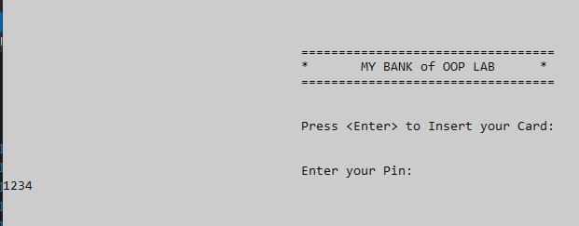
Introduction
Program ask for Insert your
Atm Card through Enter.
And ask you to enter your
4-digit unique pin number.

Slide 5
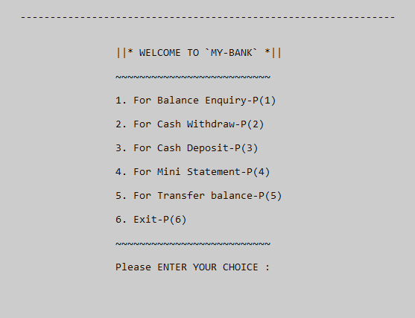
Features
Our Atm machine have different features like
“Balance Enquiry” to check latest balance (as this project is not connected to database so the initial balance is ‘0’).
“Cash Withdrawal” to withdraw cash above 100 Rs.
“Cash Deposit” to deposit your cash in your bank account.
“Mini statement” to get the statement of last transactions from bank.
“Transfer balance” transfer balance to another bank account

Slide 6
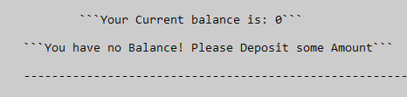
Implementation Balance Enquiry:
ATM initial balance enquiry function is shown like this:

Slide 7
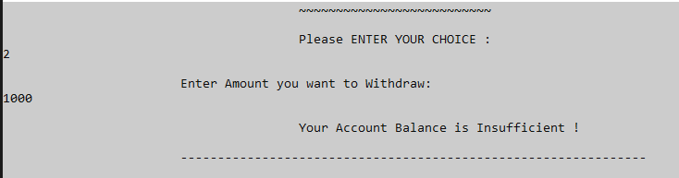
Cash Withdrawal:
The initial withdraw function is look like as:

Slide 8
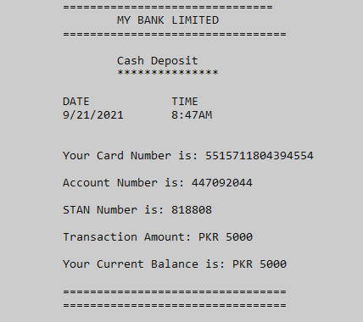
Cash Deposit:
The initial Deposit function is look like as:
“The Deposit Transcript”

Slide 9
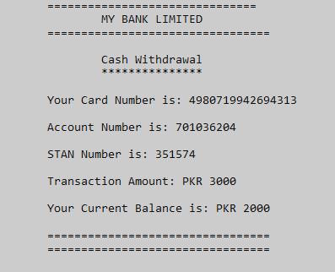
Cash Withdrawal Transcript:
If we deposit some amount to our bank account and want to withdraw amount then the withdraw slip is:
“The Withdraw Transcript”

Slide 10
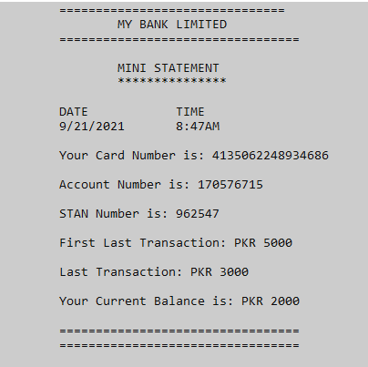
Mini Statement:
If we want to get our mini-statement from bank of last transactions:
“The Statement Transcript”

Slide 11
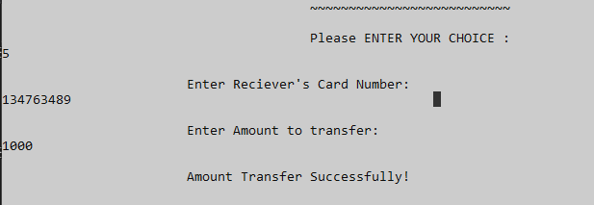
Transfer Balance:
If we want to transfer balance to another bank account:
It takes only 16 digit account number of Receiver

Slide 12




Thank you

